Slide 1

An Introduction to SAS
Susan Frankki

Slide 2
Background
SAS was created in 1960
  Originally used for statistics application in agriculture projects
Most commonly used by large scale organizations
Closed Source

Slide 3
Advantages
Updates rolled out with new releases
  Come from controlled environment and are well tested
Easy debugging
Dedicated customer service
Easy to learn
Decent graphical capabilities
Strong data security features
Good with large databases
Nice output
SQL code can be used

Slide 4
Disadvantages
Cost
Not great graphical features, makes decent graphs but they are not easily customizable
Text mining is difficult
More of a procedural language so often more lines of code compared to R

Slide 5
Syntax
Not case sensitive
Not line or space sensitive
Each line should end with a semicolon
Each code chunk ends with “run;”
F8 can be used as a short cut to run all code or highlighted code

Slide 6
Enterprise Guide
Enterprise guide is a popular IDE used at many corporations including Gundersen
Has wizards to assist with writing code, including multiple levels of autocomplete
Intuitive, customizable
Transparent access to data
Easy ways to export data and/or results

Slide 7
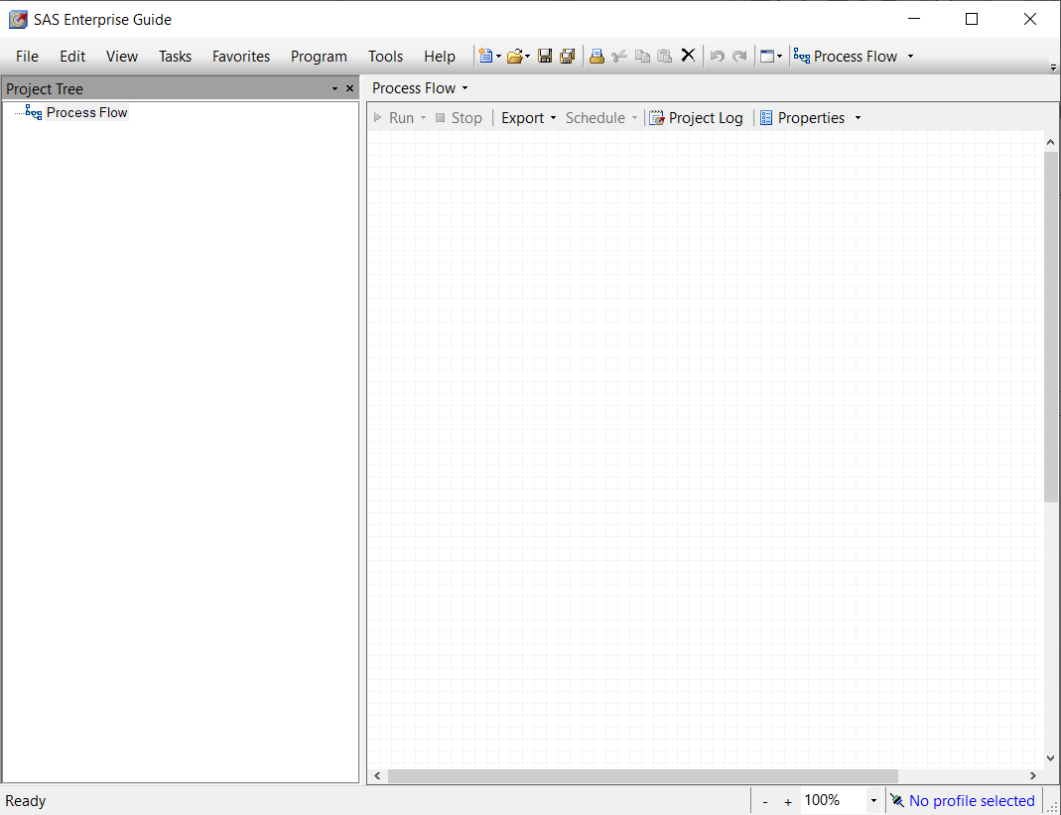
Main Screen

Slide 8
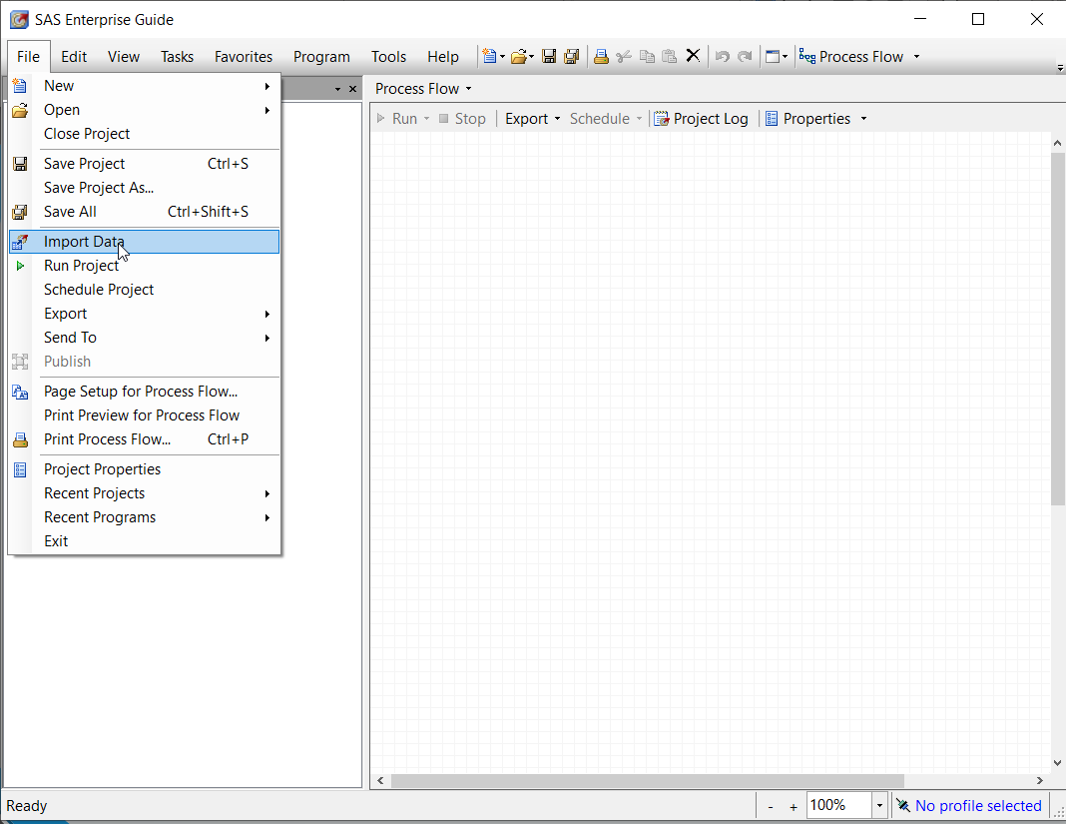
Import Data
Import data is very simple
File->Import Data then just choose the filepath
Doesn’t matter where it is located
The import wizard goes through the necessary steps to import your data

Slide 9
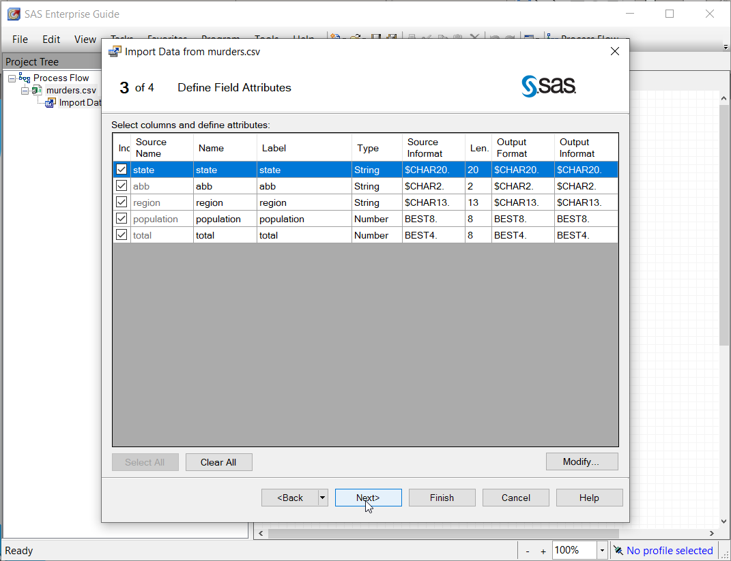
Import Data
There are various things you can change in the import data steps
The 3rd step see at the left shows the variables and types, occasionally things are read in weirdly and you might have to change the type and source informat

Slide 10
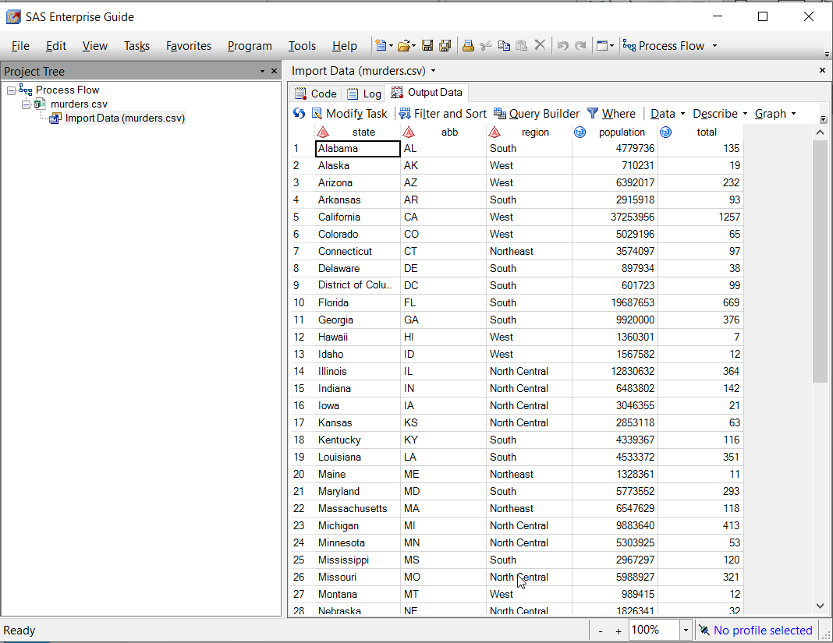
Import Data
Once data is imported it will automatically pop up as seen on the left
You can also double click the little excel symbol on the far left to open the original form of the data

Slide 11
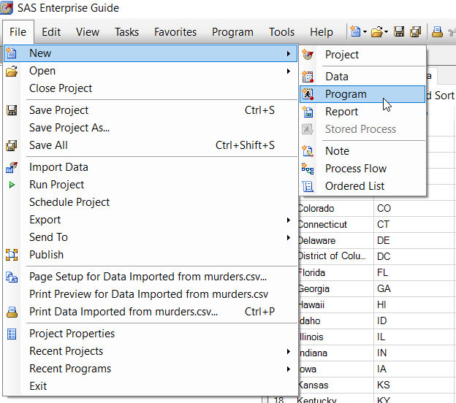
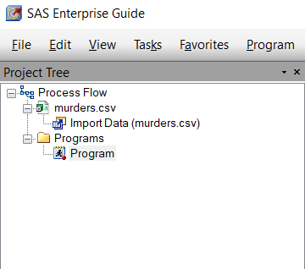
Program
To start writing code you need a program
File->New->Program
Program now pops up on the left in the project tree, you can click on it twice to rename

Slide 12
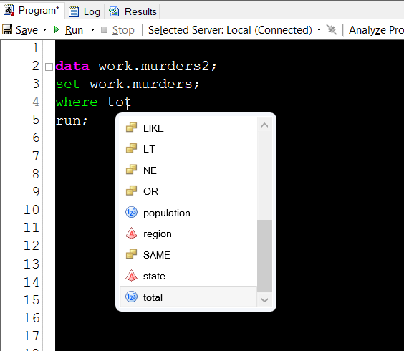
Data Step
You can use a data step to subset your data
  Say “data” followed by the name of your new data (or the same name if you want to just overwrite it)
  One example is a where statement with a variable and logical operator
You can see on the left the autocomplete option pops us with suggestions of both the available variables and the operators

Slide 13
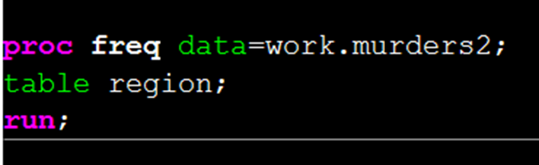
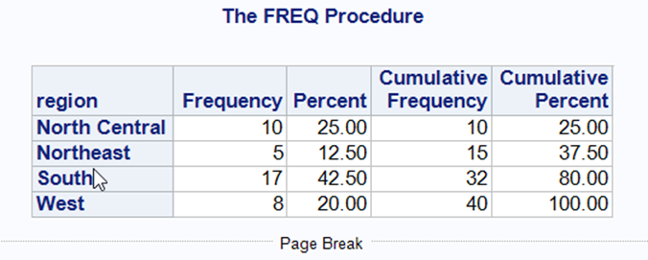
Proc Freq
A common procedure that I use constantly is the proc freq
The basic form of this procedure creates a frequency table as seen on the left

Slide 14
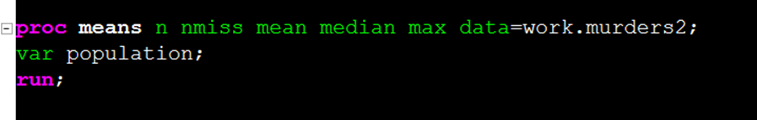
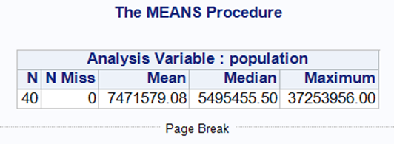
Proc Means
Another common procedure is proc means
As with other procedures you can specify what you want the output to be
  On the left you can see that after the proc means call I specify that I want n, nmiss, mean, median and max.
Output on the bottom left

Slide 15
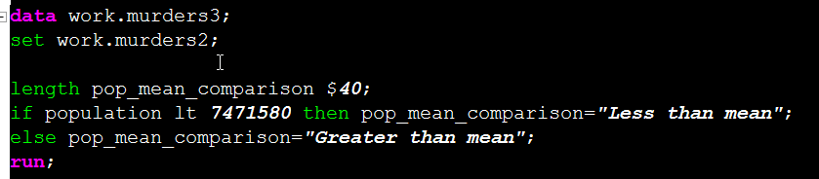
Creating New Variables
You can create new variables in a datastep
The line that starts with length specifies the length of the new character variable, without this statement length is automatically set to the first value assigned and then if subsequent values are longer they will be cut off
Basic if then statement can be used as seen

Slide 16
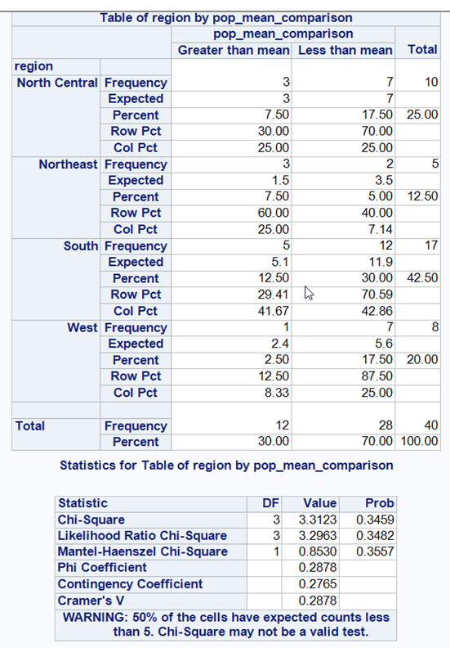
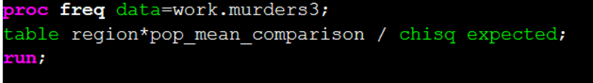
Comparing Categorical Variables
Proc freq can be used to cross tabulate 2 variables with a * symbol
Using a / you can then specify options you wish to apply to the data
  Above I apply a chi-square test and display the expected values

Slide 17
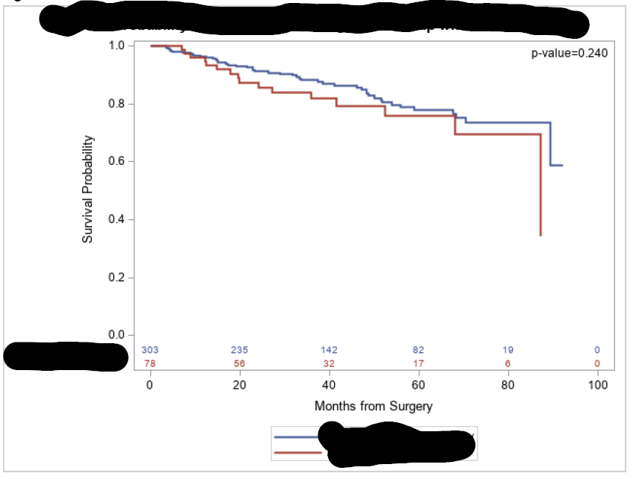
Other Procedures
The following are the main procedures I used at Gundersen
  Proc freq, proc means
  Proc lifetest for Kaplan Meier survival analysis
  Proc phreg for cox proportional hazard analysis
  Proc ttest
  Proc psmatch for propensity score matching
To the right is an example of a Kaplan Meier Curve generated by SAS (This plot cannot be shared publicly yet so I had to black out titles)

Slide 18
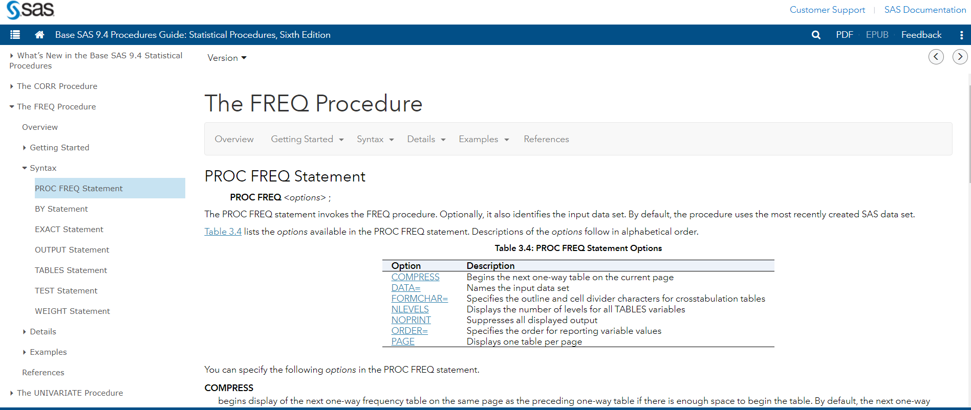
SAS Help Website
SAS help has very easy to follow documentations, a screen shot is shown below
https://documentation.sas.com/?docsetId=procstat&docsetTarget=procstat_freq_syntax01.htm&docsetVersion=9.4&locale=en

Slide 19
Other Issues I Have Had
Like with R, dates can be fussy
Occasionally things will show up weird with the data upload
While Access is a form of data that SAS accepts, it seems to cause issues and not always communicate well so it is better to export from Access to an excel document first.
Time series is in an additional package that needs to be purchased

Slide 20
Resources
There are a lot of great resources available with a quick google search, the two below are the general documentation website, and a website with a great overview and walkthrough of SAS
https://documentation.sas.com/?docsetId=procstat&docsetTarget=procstat_freq_syntax01.htm&docsetVersion=9.4&locale=en
https://data-flair.training/blogs/sas-tutorial/

Slide 21
Congratulations and Have a Great Summer
Congratulations to those who are graduating!
Good luck to everyone on their future endeavors!

